Slide 1
Homework Policy
Hillsborough Public School
Notes:
About this resource
Schools will decide how to best review existing homework policies/strategies or how best to develop a new Homework Policy.
This PowerPoint presentation should take approximately 2 hours and is designed to be flexible so that it can be presented in a variety of different contexts. Schools can:
use the slides as provided or modify/adapt them to suit specific school needs.
use the PowerPoint at one or more of the following events:
staff meeting
P&C meeting
parent/caregiver/student forum.
Feedback from this presentation should be used by the Homework Policy Committee in the development of the school’s Homework Policy.
Preparation
Along with an invitation to a meeting/forum, provide materials to prospective participants to read prior to attending the meeting/forum. Suggested pre-reading materials might include:
the Homework Policy: Research Scan (full document for staff /summary of findings for parent/caregivers/students)
NSW Department of Education and Communities’ Homework Policy
current school’s Homework Policy.
Schools may also choose to provide survey results prior to the meeting.
Requirements
PowerPoint presentation, computer, projector, activity sheets
Check that equipment is available and in working order
Ensure that there is an appropriate venue and adequate space to cater for the number of participants.

Slide 2
Definition
Homework is any task assigned by school teachers intended for students to carry out during non-school hours.
Harris Cooper, Jorgianne Civey Robinson, Erika A Patall, Does Homework Improve Academic Achievement? 2006 p.1
Notes:
Slide 3: Definition
Approximate time: 5 minutes
Instructions:
Present the definition of homework as described in the Department’s Homework Policy: Guidelines (see notes below).
Invite comments.
Notes:
For the purposes of the Department’s Homework Policy, homework is defined as any task assigned by school teachers intended for students to carry out during non-school hours designed to meet specific learning goals.
Students will also participate in a range of activities and have diverse experiences outside of school hours that will enhance their learning. Whilst these experiences and activities are to be encouraged, they are not defined as homework unless they are set by the teacher (and the teacher provides feedback to the students).

Slide 3
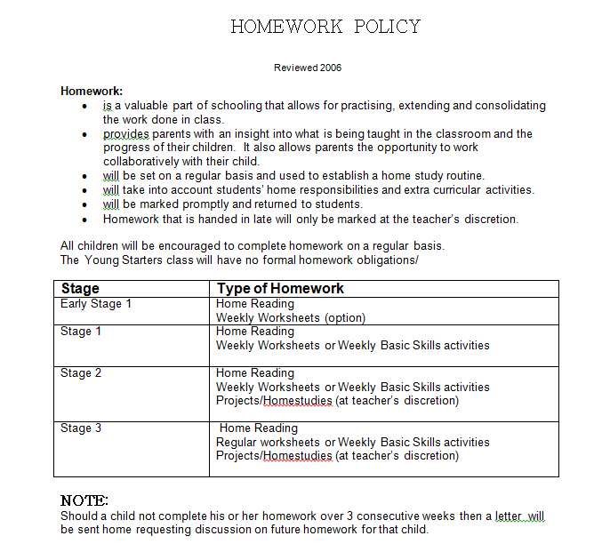
Our Current Homework Practices
Notes:
Slide 4: Activity 1: Homework
Approximate time: 20 minutes
Requirements: Activity sheet 1: Homework (What do we currently do? Why do we do this?)
Instructions:
Form small groups.
Ask one person in each group to complete Activity sheet 1: Homework based on the group discussion.
Ask a member of each group to report back briefly.
Collect the activity sheet from each group for the Homework Policy Committee.

Slide 4
Our Current Homework Practices
What does that look like in our classrooms?
Weekly worksheets
Spelling list practice
Home Reading
Maths activities
Special Projects
Notes:
Slide 4: Activity 1: Homework
Approximate time: 20 minutes
Requirements: Activity sheet 1: Homework (What do we currently do? Why do we do this?)
Instructions:
Form small groups.
Ask one person in each group to complete Activity sheet 1: Homework based on the group discussion.
Ask a member of each group to report back briefly.
Collect the activity sheet from each group for the Homework Policy Committee.

Slide 5
Current Educational Research
What does the research say?
Notes:
Slide 5: Activity 2: Research
Approximate time: 20 minutes
Requirements: Activity sheet 2: Research
Instructions:
Form small groups to discuss the Homework Policy: Research scan or use Activity sheet 2: Research to stimulate discussion about views on homework and about what the current research shows.
If using the activity sheet, assign each group 3-4 statements to discuss.
Ask each group to record the discussion.
Ask each group to report back to the whole group.
Collect a record of the discussion for the Homework Policy Committee.

Slide 6
HOMEWORK: PRO and CON
While there is no consensus in the literature as to whether homework raises student achievement, homework advocates claim that homework does so by increasing total study time covering more of the curriculum, and reinforcing work covered in class.

Slide 7
HOMEWORK: PRO and CON
Advocates believe that through homework, students can learn to use resources effectively and develop good study habits.
Supporters also claim that homework has non-academic benefits, especially for younger students, including:
- improving students’ time management and organisational skills
- improving attitudes toward school and showing that learning can take place outside of the classroom
- fostering a sense of personal responsibility and self-discipline

Slide 8
HOMEWORK: PRO and CON
Homework may promote a greater parental appreciation of, and involvement in, schooling. Parental involvement in homework may improve students’ homework completion rates and parents’ attitudes toward their children’s schools.
The research suggests that parents should be somewhat, but not too greatly, involved in their children’s homework.

Slide 9
HOMEWORK: PRO and CON
Current educational research finds little credible evidence that homework yields non-academic benefits, and concludes that there is no evidence that homework helps students develop time management skills.

Slide 10
HOMEWORK: PRO and CON
As a teaching strategy, homework can have major limitations. Since the work is done in the absence of a qualified teacher and there is no control over who actually completes the homework, this also raises issues with differences in explanations etc.

Slide 11
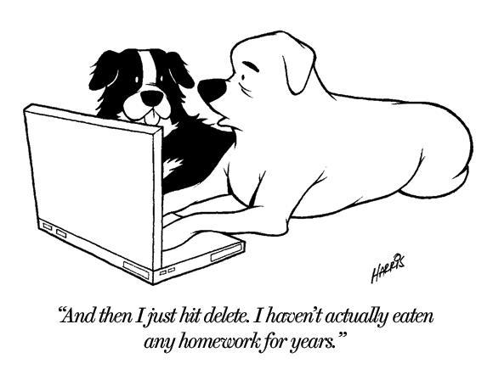
HOMEWORK: PRO and CON
Some also warn that homework can inhibit independent learning because students become preoccupied with work assigned by someone else. It can curtail the time available for other activities, such as sports and community activities.
There is evidence that homework does cause stress for students) and it may even create tension
between parent and child.

Slide 12
In Summary
The ‘more homework the better’ view has no research support, the quality of the homework assigned is more important than the quantity
Homework must be purposeful and relevant to student needs and should not jeopardise the right of children to enjoy a balanced lifestyle
The amount of homework and time spent on it should accord with the student’s age and developmental level
Effort spent on homework is a stronger correlate of academic achievement than time spent on homework
Most researchers conclude that for primary students, there is no evidence that homework lifts academic performance.

Slide 13
Key Features of Effective Homework
Our Policy Review

Slide 14
3 key considerations
Quality
Manageability
Communication
Notes:
Slide 6: 3 key considerations
Approximate time: 15 minutes
Requirements: Slides 5, 6, 7 and 8
Instructions:
Use the slides to present these 3 considerations.
Invite any comments.
Notes:
The research shows that there are three key considerations when developing effective homework tasks and when considering the development of a school Homework Policy: Quality, Manageability and Communication.

Slide 15
Quality
Effective homework tasks are:
appropriate for each student's age and ability
relevant to each student’s needs and builds on work undertaken in class
purposeful and designed to meet specific learning goals
clearly stated and requirements made explicit during class time
varied and challenging, but achievable
supported by teacher strategies for students having difficulties with homework.
The quality of the homework assigned is likely to be more important than the quantity
Notes:
Slide 7: Quality
Notes:
Homework tasks should be assigned by teachers with a specific, explicit learning purpose. On completion, teachers should acknowledge student effort and provide feedback related to student learning.

Slide 16
Manageability
Homework should:
be manageable for both students and teachers
take into account students’ access to resources and technology
be clearly communicated to students
provide some flexibility and options to allow for different student circumstances
consider students' other commitments, such as sport, cultural activities, tuition outside of school hours, part-time employment and home responsibilities.
The quality of the homework assigned is likely to be more important than the quantity
Notes:
Slide 8: Manageability
Notes:
Quality homework is well planned and feedback is provided by teachers to students on completion. The quantity of homework needs to be manageable so that teachers can ensure quality.
Secondary schools need to consider mechanisms to plan and monitor the amount of homework given to students across all subjects, particularly in Year 7.

Slide 17
Communication
Communication means:
collaboration in the development of the school’s Homework Policy
provision of clear information between teachers, parents/caregivers and students regarding homework expectations and the completion of tasks
guidance and assistance for those having difficulties completing their homework.
Notes:
Slide 9: Communication
Notes:
Communication and the provision of clear information between teachers, parents and students is a requirement of an effective school Homework Policy. In developing a policy, the school community needs to determine what communication approaches and processes will be most effective for parents, students and teachers.
It is important to make sure students know what is required of them in completing assigned work and that parents/caregivers understand what the school’s expectations are.

Slide 18
Survey: Parents/caregivers
What would you like to see in our Homework Policy?
What approach to Homework do you feel is most effective for your children?
Notes:
Slide 10: Survey: Parents/caregivers
Approximate time: 15 minutes
Requirements: Data analysis
Instructions:
Schools will need to provide this data for presentation and discussion after analysis of the parent/caregiver survey.

Slide 19
Next steps
Parent survey made widely available
Students complete a Homework survey around what they feel is most effective
Staff surveyed around what they find most effective
Using this information the HPS Homework Policy will be revised for 2017.
Policy to be published on our website when complete
Notes:
Slide 12: Activity 3: Our school
Approximate time: 30 minutes
Requirements: Activity sheet 3A: Our School-Quality; Activity sheet 3B: Our School-Manageability; Activity sheet 3C: Our School-Communication
Instructions:
Form 3 groups and hand out Activity sheets 3A, 3B and 3C.
Draw conclusions from the surveys and from the views expressed by the staff and relate this to what the school will include in its policy. Stimulus questions appear on each of the three activity sheets.
Record comments.
Collect the activity sheets for the Homework Policy Committee.

